Slide 1
Chapter 3:
The Enhanced E-R Model
Modern Database Management
10th Edition
Jeffrey A. Hoffer, V. Ramesh,
Heikki Topi
© 2011 Pearson Education, Inc. Publishing as Prentice Hall

Slide 2
Supertypes and Subtypes
Enhanced ER model: extends original ER model with new modeling constructs
Subtype: A subgrouping of the entities in an entity type that has attributes distinct from those in other subgroupings
Supertype: A generic entity type that has a relationship with one or more subtypes
Attribute Inheritance:
  Subtype entities inherit values of all attributes of the supertype
  An instance of a subtype is also an instance of the supertype

Slide 3
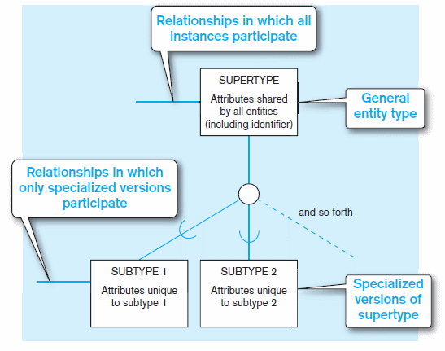
Figure 3-1 Basic notation for supertype/subtype notation
a) EER notation

Slide 4
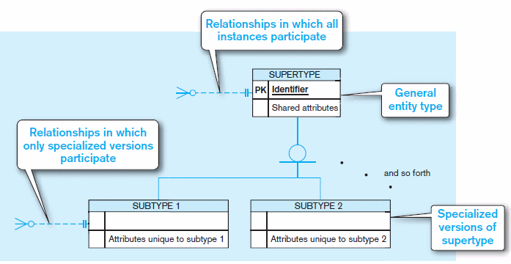
Figure 3-1 Basic notation for supertype/subtype notation (cont.)
b) Microsoft Visio Notation
Different modeling tools may have different notation for the same modeling constructs

Slide 5
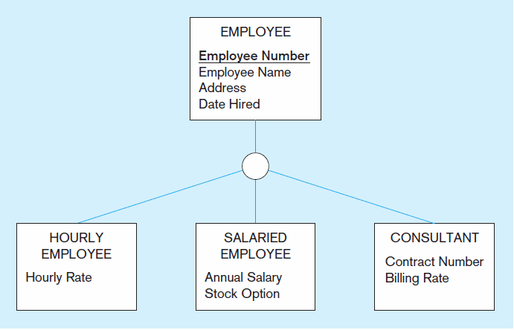
Figure 3-2 Employee supertype with three subtypes
All employee subtypes will have employee number, name, address, and date hired
Each employee subtype will also have its own attributes

Slide 6
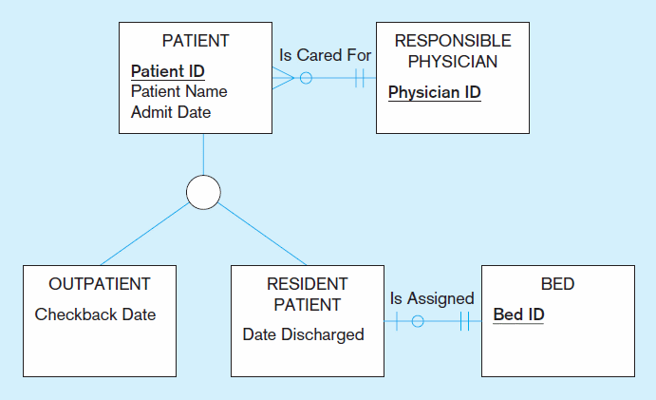
Figure 3-3 Supertype/subtype relationships in a hospital
Both outpatients and resident patients are cared for by a responsible physician
Only resident patients are assigned to a bed
Notes:
Both Residential and Outpatient sub-types inherit the physician responsible

Slide 7
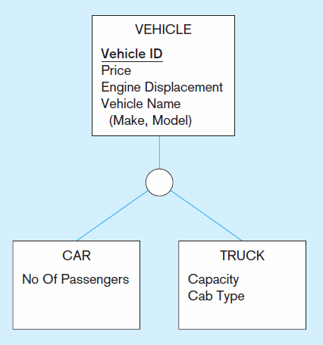
Figure 3-4 Example of generalization (cont.)
b) Generalization to VEHICLE supertype
So we put the shared attributes in a supertype
Note: no subtype for motorcycle, since it has no unique attributes
Notes:
Generalization -> top down approach !

Slide 8
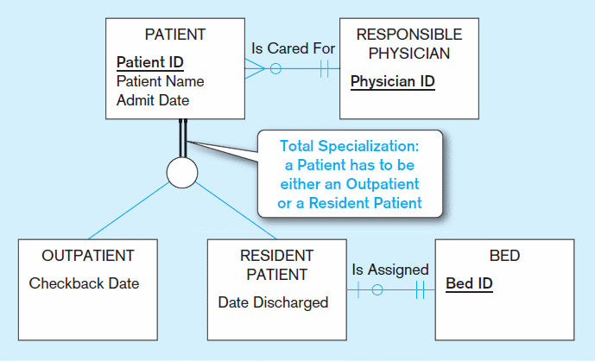
Figure 3-6 Examples of completeness constraints
a) Total specialization rule
Notes:
Completeness contains
Double line = Must exist in one of the subtype
Single Line = May or may not

Slide 9
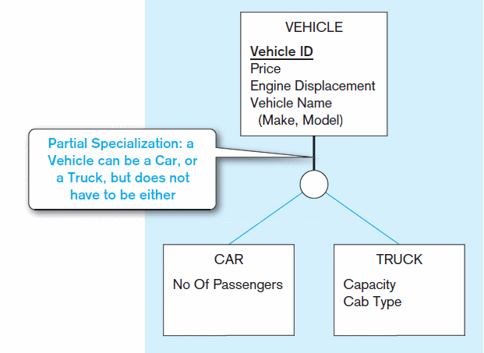
Figure 3-6 Examples of completeness constraints (cont.)
b) Partial specialization rule

Slide 10
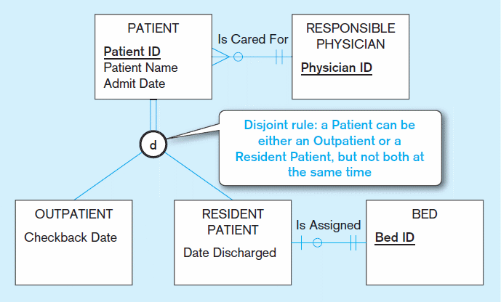
Figure 3-7 Examples of disjointness constraints
a) Disjoint rule
Notes:
Disjointness constraints
D = may be either one or the other, but not both

Slide 11
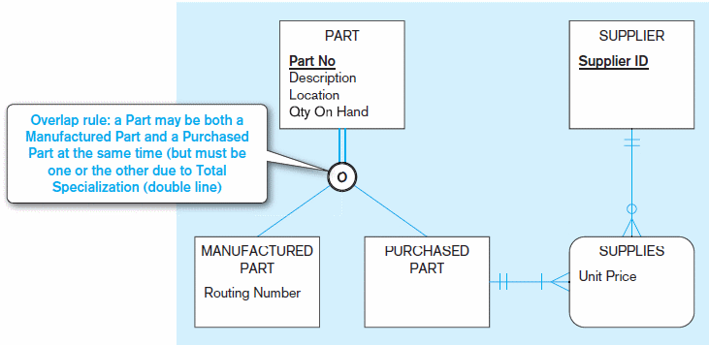
Figure 3-7 Examples of disjointness constraints (cont.)
b) Overlap rule
Notes:
Overlap -> self explanatory
A part may be one or the other, or both

Slide 12
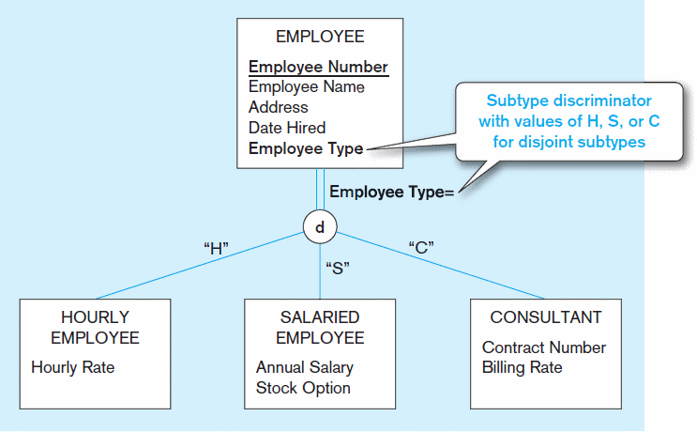
Figure 3-8 Introducing a subtype discriminator (disjoint rule)
Notes:
Subtype Discriminator = tells the model which subtype is used

Slide 13
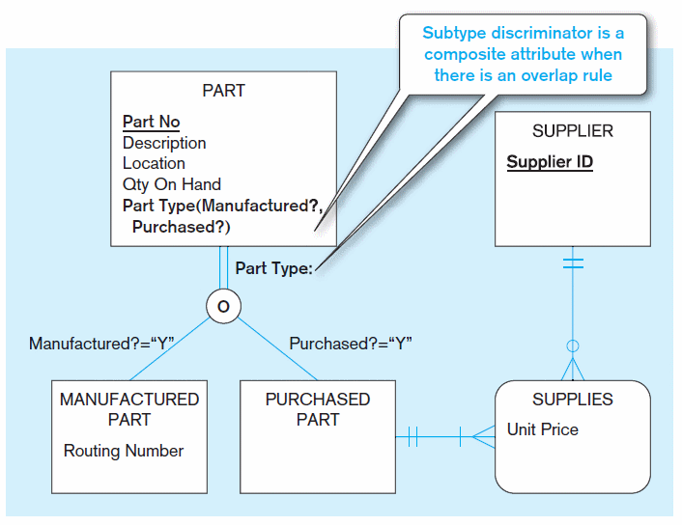
Figure 3-9 Subtype discriminator (overlap rule)
Notes:
Overlap discriminator with overlap -> implemented as Flags

Slide 14
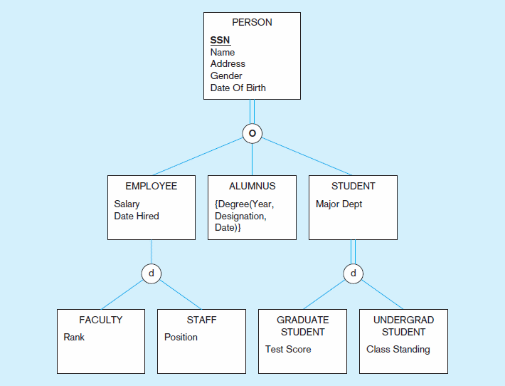
Figure 3-10 Example of supertype/subtype hierarchy
Notes:
There could be many levels of the hierarchy

